Slide 1
FLS 14
Johnny Vogt

Slide 2
Quick Quiz Questions
B
B
C
C

Slide 3
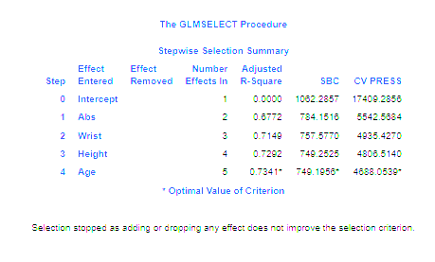
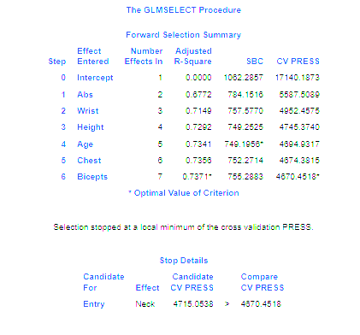
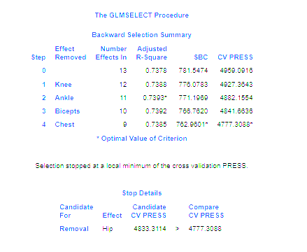
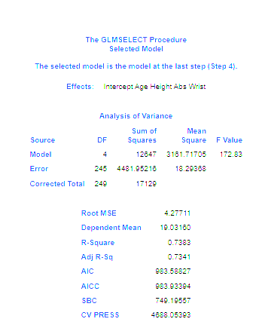
Screen shots of each Selection Summary

Slide 4
Results interpretation
between all three models, the Stepwise selection had the lowest CVPRESS Value, which would point to that model having the least amount of errors...I think
Each model have very similar R^2 values, which would let us defer to the CVPRESS Value.

Slide 5
Take Aways
Are we done with FLS’s
Im still not quite sure how the forward, backward, and Stepwise actually decide which variables are best to use
I’m still a bit confused about what the CVPRESS Values is trying to do
I spent like 2 hours trying to figure out how to get the CVPRESS value for the project and was VERY confused, I shouldve just watched this week’s videos.

